Slide 1
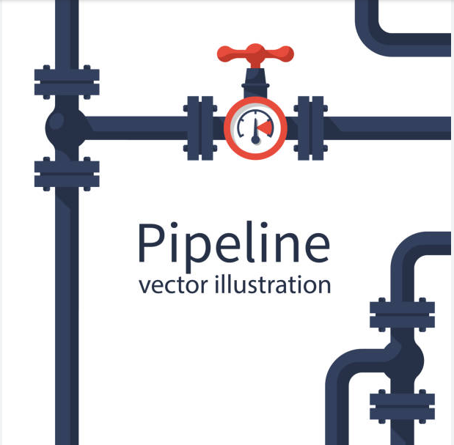
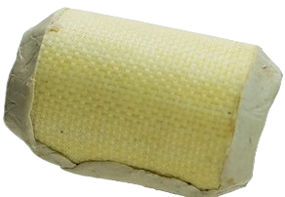


Retrieval-Augmented Generation in a Low Lexical Diversity Scenario
Applied Data Science Project 20/02/2025
Team 1: Minal Jamshed, Prima Acharjee, Michele Pantaleo

Slide 2




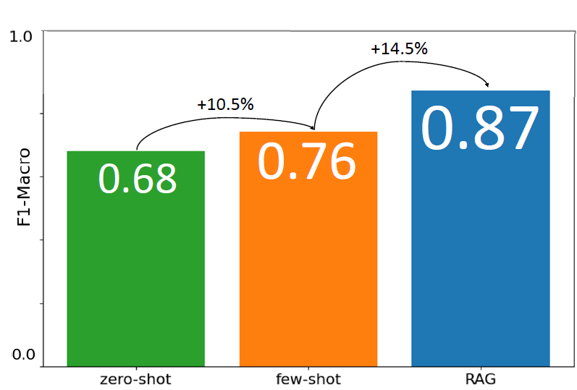
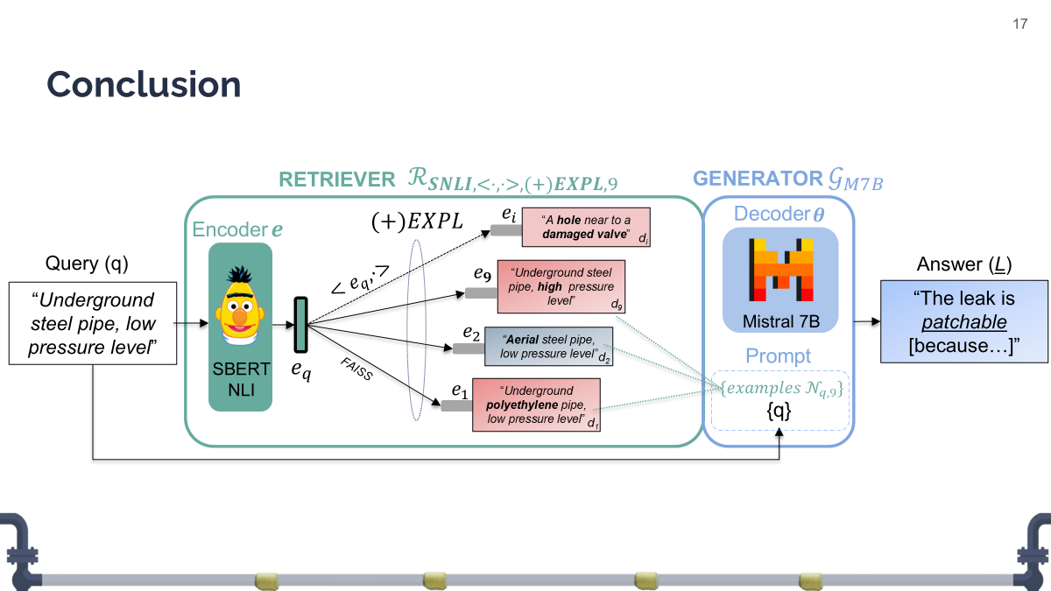


Outline
Aerial steel pipe, low pressure level
$$e$$
$$θ$$
Aerial steel pipe, high pressure level
1. Objective
2. Hypothesis
3. Methodology
4. Evaluation
5. Conclusions

Slide 3





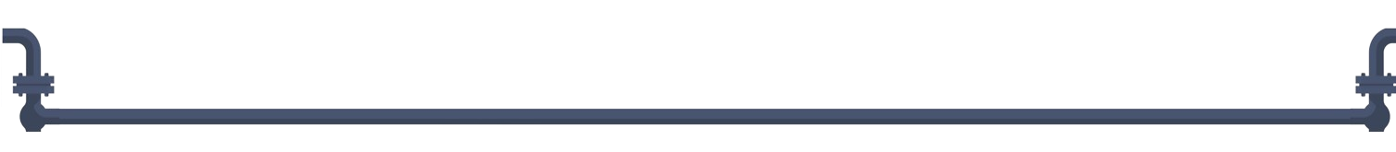
Objective
Evaluate the potential of a RAG system in developing a chatbot to assist gas fitters in the application of Patch MadFlex, a product of Composite Research (CoRe).
99% fails
History & AI
SDGs
Notes:
First Step of the Research and Innovation Pathway.
Why: patching fails 99%
Who: gasfitters,CoRe, ItalGas
How: chatbot backed by a retrieval system (Retrieval Augmented Generation RAG).
How (stakeholders' benefits): an opinion based on application history.

Slide 4






Value Proposition
Innovate
Reduce Gas Leaks Impact
Improve Safety
Notes:
BRINGING the Innov through AI- SDG 9 (Industry, Innovation, and Infrastructure):
Decision making tool to FOSTER smarter data driven solution
SUSTAINABILITY of infrastrusture on the gas industry.
REDUCING Env impact(Responsible Consumption and Production)
instd of going through an OVERALL replacement the proj
- is PROMOTING RESOURCE EFFICIENCY - REPAIR instd of REPLACeMENT
- MINIMIZING the waste of material.
- Lessening the chances of gas leaks which is helping in BETTER URBAN ENVIRONMENT. IMPROVING safety SDG 11 (Sustainable Cities and Communities)-
- Ensures safety for the workers,
- For the communities by addressing gas leaks for effectively

Slide 5
Hypothesis
A retrieval system can enhance an LLM’s performance even in low-lexical-diversity scenarios, where retrieved documents are highly similar to each other.
Aerial steel pipe, low pressure level
Aerial steel pipe, high pressure level
A. Even a single word can impact patch applicability
B. Most common words mirror feature names of the original tabular dataset.

Slide 6
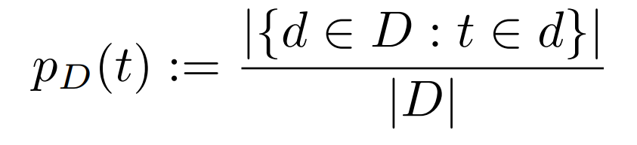
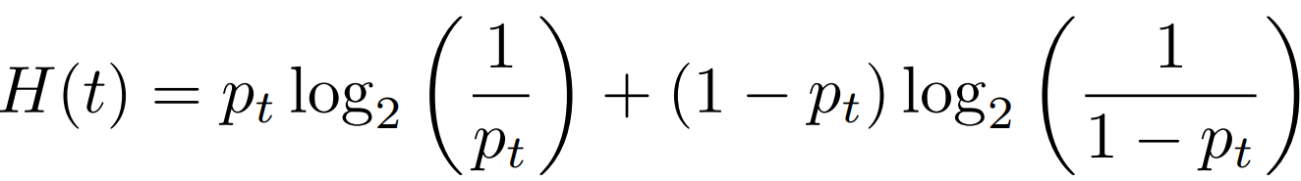
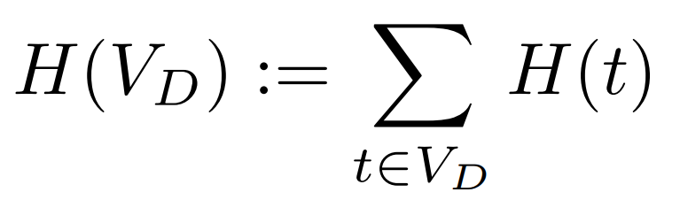
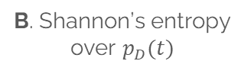
Corpus Lexical Entropy
Lexical Entropy quantifies the lexical similarity in a corpus. The metric quantifies our understanding: our corpus exhibits significantly higher document similarity than other domain-specific corpora, such as PubMed-QA. This highlights the unique challenge of retrieval in our setting.
A. Probability of term t in document d
B. Shannon’s entropy over $p_{D}(t)$
C. Corpus Lexical Entropy

Slide 7
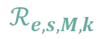
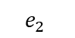

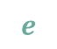


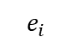

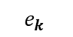
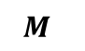
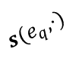
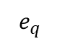
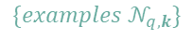
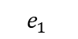
Method
Define a training-free search space $𝓢$ over RAG components $e,s,M,k, θ$ and constrain LLM’s answer to YES or NO through the prompt to facilitate evaluation.
RETRIEVER
$$ℛ_{e,s,M,k}$$
GENERATOR
$$𝒢_{θ}$$
$$e_{i}$$
Decoder
$$e$$
$$M_{ }$$
“A hole near to a damaged valve”
$$θ$$
Encoder
d_{i}
$$θ$$
Query (q)
$$e_{k}$$
Answer (L)
$$e$$
$$s(e_{q},⋅)$$
“Underground steel pipe, high pressure level”
Underground steel pipe, low pressure level
d_{k}
The leak is patchable [because…]
$$e_{2}$$
“Aerial steel pipe, low pressure level”
Prompt
$$e_{q}$$
_{FAISS}
d₂
$$e_{1}$$
“Underground polyethylene pipe, low pressure level”
$$\{examples 𝒩_{q,k}\}$$
{q}
d₁
Searchable RAG.
Notes:
Skeleton
Read then show the workflow
Low Lexical Entropy + Synthetic Nature sets overfitting risk too high: finetuning would prevent us from a fair evaluation over real-world cases

Slide 8
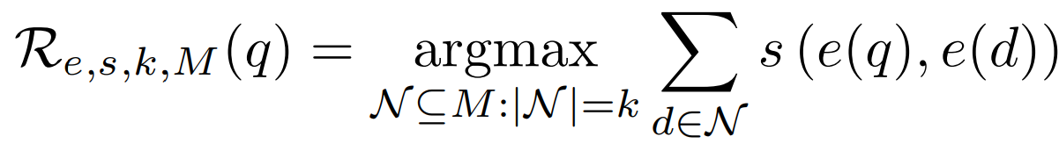
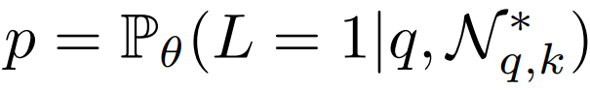
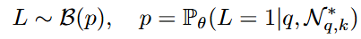

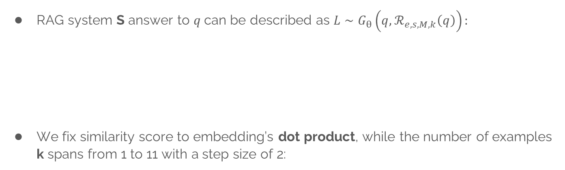
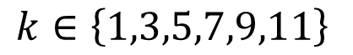
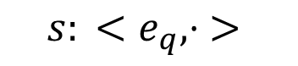

Method: formalization, similarity $s$and $k$
RAG system S answer to $q$can be described as $L∼G_{θ}\left(q,ℛ_{e,s,M,k}\left(q\right)\right):$
We fix similarity score to embedding’s dot product, while the number of examples k spans from 1 to 11 with a step size of 2:
Query
RETRIEVER
$$ℛ_{e,s,M,k}$$
GENERATOR
$$𝒢_{θ}$$
Answer
q
L
$${s: <e}_{q}, ⋅ >$$
$$k∈\left\{1,3,5,7,9,11\right\}$$
A. Inner Product
B. Number of examples
Notes:
Similarity Score according previous study
K spans from 1 to 11 with a step size of 2
Mathematical Formulation enlights two imortan aspects:
The decoder is the direct respoinsible of the evaluation
Patchability is modeled with a degree of uncertainity (bernoullian because either patchable or not)
For this reason we must look for a decoder with in-domain knowledge…

Slide 9
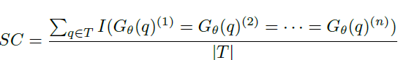
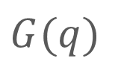
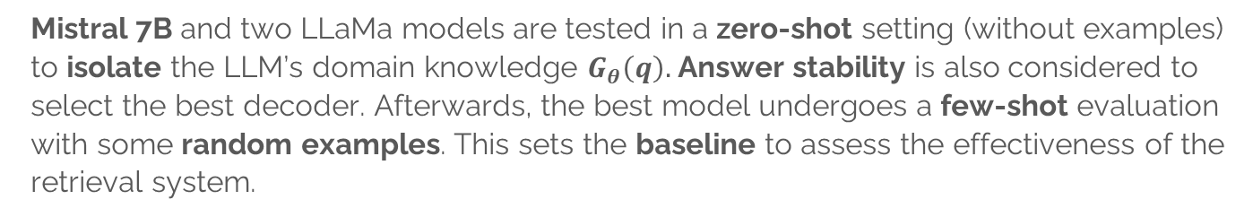
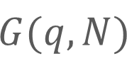
Method: decoder $θ$.
Mistral 7B and two LLaMa models are tested in a zero-shot setting (without examples) to isolate the LLM’s domain knowledge $G_{θ}\left(q\right).$ Answer stability is also considered to select the best decoder. Afterwards, the best model undergoes a few-shot evaluation with some random examples. This sets the baseline to assess the effectiveness of the retrieval system.
$$G(q)$$
$$G(q,N)$$
A1. Zero-Shot
A2. Consistency
B. Few-Shot
Notes:
For this reason we must look for a decoder that shows:
In-domain knowedge → answer without context, namely zero-shot fashion
Be consistent if asked n times about the same query. We won’t the model to flip the coin
The best model sets the baseline for the rag system:
We provide the model a fixed context (k examples, identical for all the queries) and we measure performances
The retrieval system backing the decoder implies a cost. We expect that the value brougth by this cost overtakes random context.
And this value, brought from
There are no special requirements fot the LLM but open-source and freely accessibility, thus we test Mistral-7B along with two lama’s model

Slide 10
Method: Memory $M$
Hypothesis: reducing the density of non-patchable cases creates a more balanced context for the decoder $θ$, improving performance. (+)EXPL is an algorithm that removes negative samples within an adaptive radius $r_{EXPL}$.
-
-
-
-
-
-
-
-
-
-
-
-
-
-
-
-
-
+
-
-
-
-
-
-
-
-
-
-
-
-
-
-
-
-
-
-
-

Slide 11
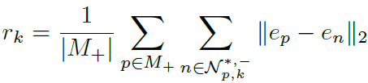
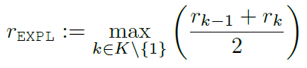

Method: Memory $M$
Hypothesis: reducing the density of non-patchable cases creates a more balanced context for the decoder $θ$, improving performance. (+)EXPL is an algorithm that removes negative samples within an adaptive radius $r_{EXPL}$.
-
-
-
-
-
-
-
-
-
-
-
-
-
-
-
-
-
-
-
-
-
-
-
-
-
-
-
-
-
-
+
-
-
-
+
-
-
-
-
$$r_{EXPL}$$
-
-
-
-
-
-
-
-
-
-
-
-
-
-
-
-
-
-
-
-
-
-
-
-
-
-
-
-
-
A. Overcrowded positive point [ALL]
B. Overcrowded positive point [(+)EXPL]
C. Explosion range definition
Notes:
Data cleaning
Sacrifice completeness for consistency
REMOVED EXAMPLES ARE COSNIDERED NOISE

Slide 12
Method: encoder $e$
Adjectives and negations significantly influence reparability: SNLI models are trained to detect logical relationships between sentences.
Aerial steel pipe, high pressure level
_{B1}
C
S
Aerial steel pipe, low pressure level
_{A}
N
!S
Underground steel pipe, low pressure level
_{B2}
A. NLI (Entail, Neutral, Contradict) vs Semantic Similarity STS ([!]Similar)
Notes:
Read the first sentence
Read sentence A
Point out

Slide 13
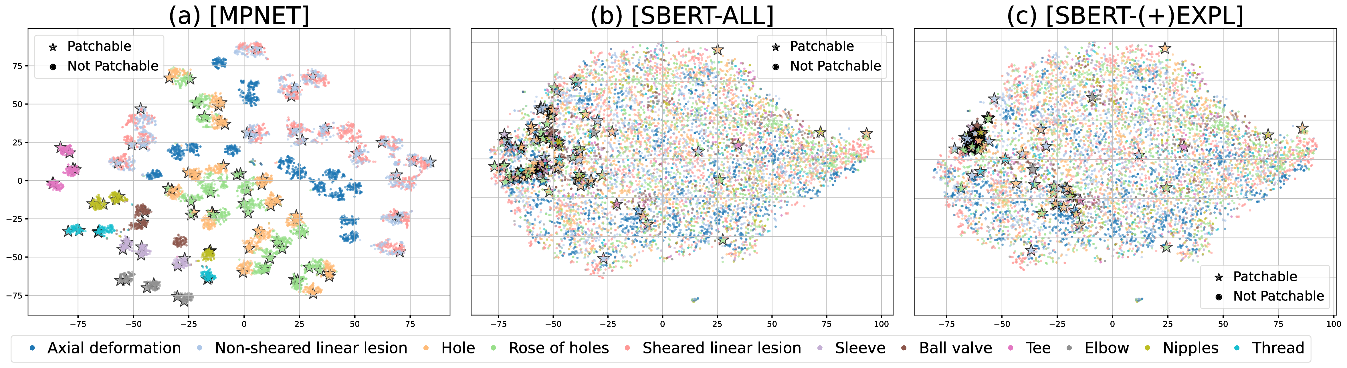
Method: encoder $e$
Adjectives and negations significantly influence reparability: SNLI models are trained to detect logical relationships between sentences. We expect SBERT-NLI outstanding state-of-the-arts STS models.
Aerial steel pipe, high pressure level
_{B1}
C
S
Aerial steel pipe, low pressure level
_{A}
N
!S
Underground steel pipe, low pressure level
_{B2}
Damage types:
A. NLI (Entail, Neutral, Contradict) vs Semantic Similarity STS ([!]Similar)
B. t-SNE visualization of embedding spaces. SBERT accumulates patchable points closely.

Slide 14



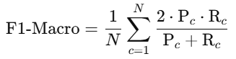
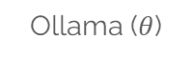

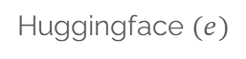
Evaluation
This project was developed on a Jupiter Notebook in Python:
F1-MACRO allows a fair evaluation of the system on both labels:
$$e$$
CoLab (T4)
Huggingface $(e)$
Ollama ($θ$)
F1-MACRO

Slide 15

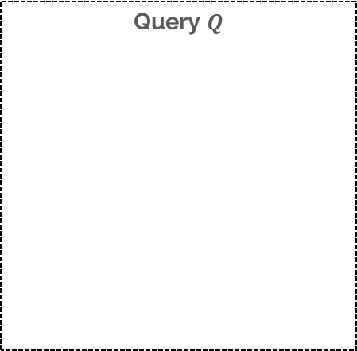



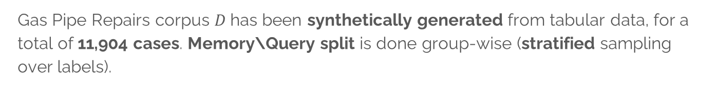

Evaluation: Dataset, $M$s and $Q$s.
Gas Pipe Repairs corpus $D$has been synthetically generated from tabular data, for a total of 11,904 cases. Memory\Query split is done group-wise (stratified sampling over labels).
Query $Q$
Corpus
Memory $M$
F
11778
9422
8904
20%
80%
-518
-2246
2356
T
126
100
101
101
25
25
$$Q_{d}$$
$$Q$$
D
$$M_{ALL}$$
$$M_{EXPL}$$

Slide 16
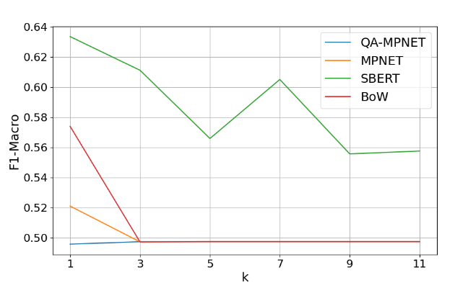
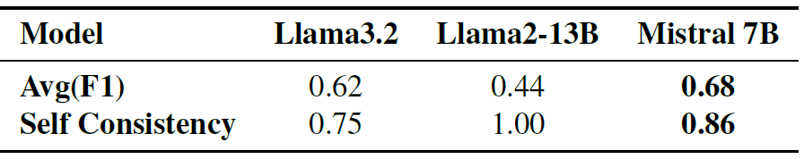
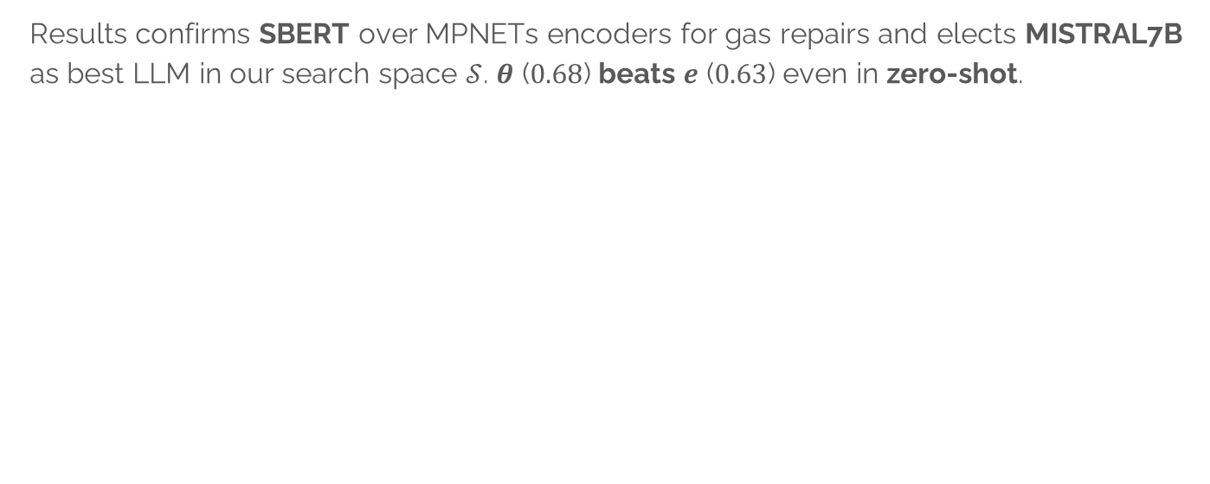
Evaluation: $e$ and $θ$
Results confirms SBERT over MPNETs encoders for gas repairs and elects MISTRAL7B as best LLM in our search space $𝒮$. $θ$ ($0.68$) beats $e$ ($0.63$) even in zero-shot.
Decoders (zero-shot)
Encoders (k-NN)

Slide 17
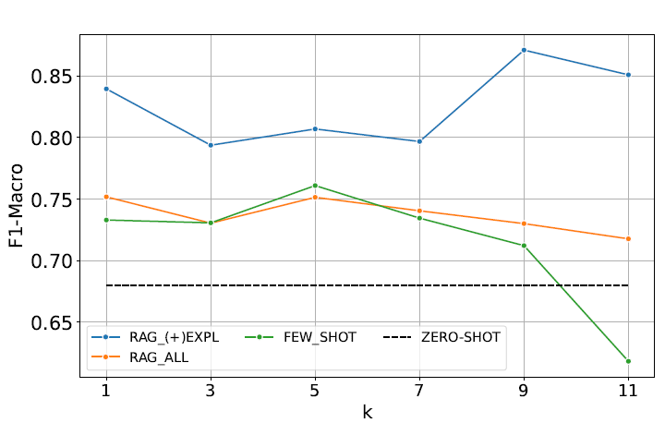
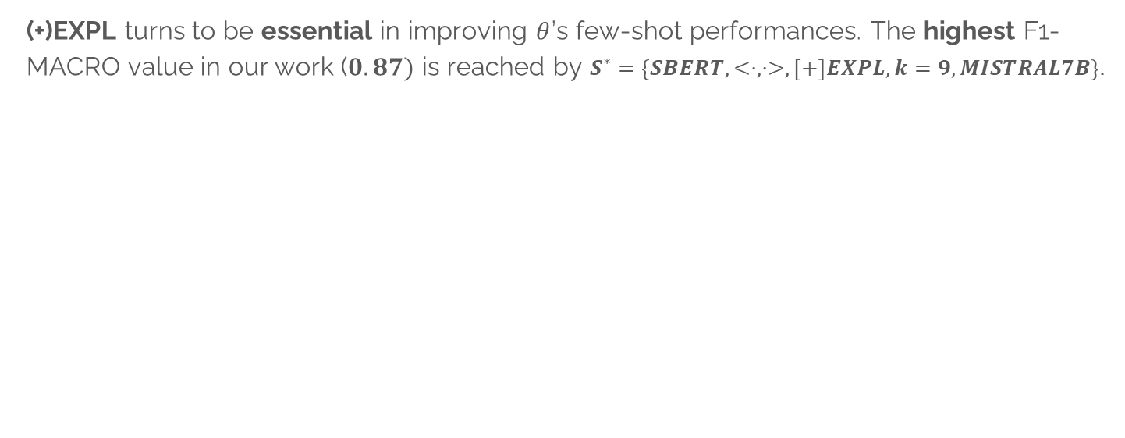
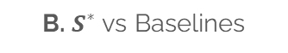

Evaluation: RAG Systems and best solution $S^{∗}$
(+)EXPL turns to be essential in improving $θ$’s few-shot performances. The highest F1-MACRO value in our work ($0.87)$ is reached by $S^{∗}=\left\{SBERT, <⋅, ⋅>,\left[+\right]EXPL,k=9,MISTRAL7B\right\}.$
$$S^{∗}$$
A. RAG with (+)EXPL (in blue) outstands for regardless the number of examples k.
B. $S^{∗}$ vs Baselines

Slide 18
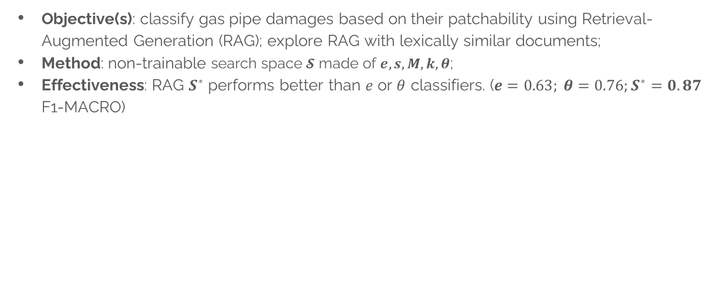
Conclusion
Objective(s): classify gas pipe damages based on their patchability using Retrieval-Augmented Generation (RAG); explore RAG with lexically similar documents;
Method: non-trainable search space $𝓢$ made of $e,s,M,k, θ$;
Effectiveness: RAG $S^{∗}$ performs better than $e$ or $θ$ classifiers. ($e=0.63; θ=0.76;S^{∗}=0.87$ F1-MACRO)
$S^{∗}$ : the best configuration explored in this work

Slide 19
THANK YOU!
Grazie!
ধন্যবাদ
شکریہ
Notes:
Bengalese: dhonnobaad
Urdu: shukrya

Slide 20
Oral Exam
20/02/2025

Slide 21
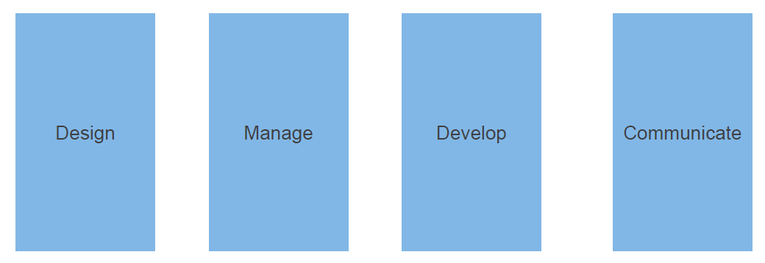
Pillars
t
1
2
3

Slide 22
DESIGN
Pillar 1

Slide 23
Define the three Os
Objective: reduce madflex wasting;
Outcome: drive gasfitters decision through history + AI;
Output: chatbot.

Slide 24
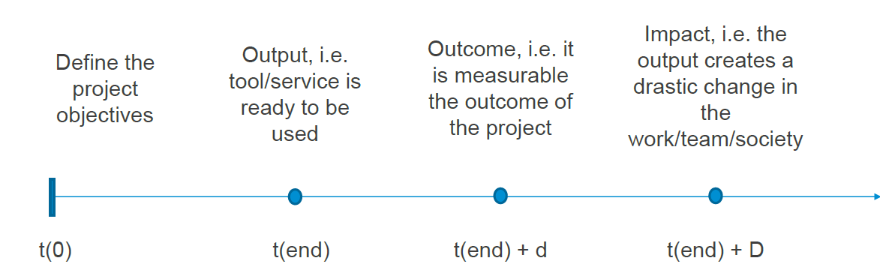
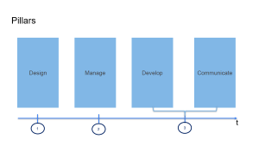
Project Timeline

Slide 25
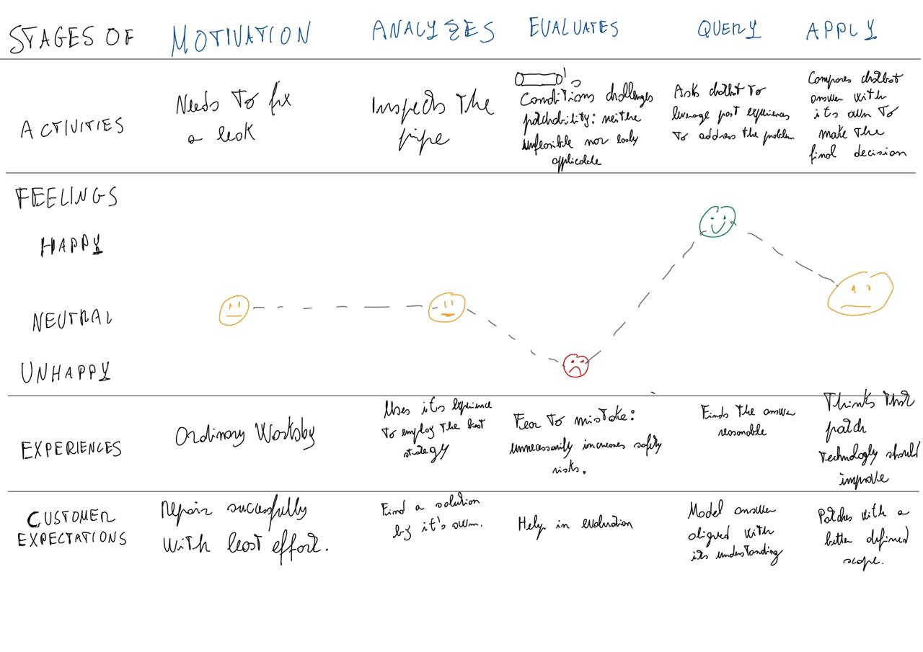
Customer Journey
Persona’s journey through the interaction with the system

Slide 26

Persona
user requirements
Fictional stakeholder. They prototype of a stakeholder.
Name: Rashid Khan
Nationality: Italian
Job: Gasfitter @FixThePipe;
Story: Finds difficult to figure the application scope of MadFlex Patch which seems to be very effective when applied. Needs help in evaluating leaks from something who got access to past cases. Expects a lead to the best solution when patchability is challenging but yet feasible. Such track must be easy to use, without needing of out-domain skills e.g. IT SKILLS, (Excel, R Studio). Reaching internet network might be challenging while dealing with pipes, thus Rashid should have the possibility to query such helper offline.

Slide 27
Use Cases
Called to repair a gas leak;
Analyze the damage:
Repairs if the situation is clear enough;
Continues to 3 otherwise.
Gasfitter asks CHATBOT for advice;
Gasfitter makes its own decision taking into account CHATBOT supports:
Applies Madfex Patch
Opt for a different solution (e.g. welding)
Monitors reparation.

Slide 28
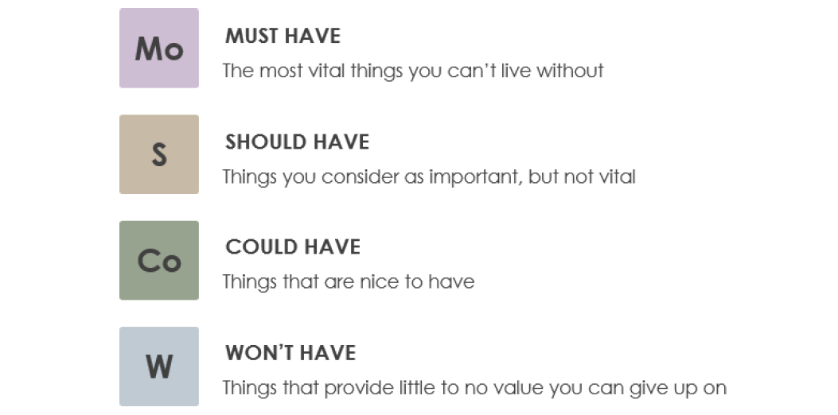
Priorities
Answers, Motivates accurately
API; Link to past cases. Human-written cases.
Offline access, Image-to-text
Audio-to-text.

Slide 29
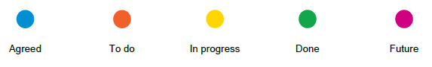
Functional Requirements
Functionalities that the project should implement.
Requirement | Status | Actions | Priority
Human-written history | Todo | Collect data | Should
Image-to-text | Future | Collect images | Could
Answer (Label) | Done | Answers P/NP | Must
Gas Pipe Repairs Understanding | In progress | Evaluate motivations | Must
Offline | To do | DBMS compressed | Could
Link to Past History | To do | Returns IDs of NN | Should
API | Future | Develop Interface | Should

Slide 30


Functional Diagram
Whole Project
[...] compatible with the use of the kit.
[…] due to a damaged valve

Slide 31
Functional Diagram
Software/Architecture

Slide 32




KPI
KPIs of our project:
$$\frac{\#MISTAKES}{\#APPLICATION}$$
$$\frac{\#HumanInterventions}{\#Queries}$$
$$\frac{\#Chatbot^{′}s successful decisions}{\#Not Patchable According to Experts}$$
A. Application’s accuracy
B. Human Escalation
C. Better Human Performances (1)
$$\frac{\#Chatbot^{′}s successful decisions}{\#Not Patchable According to Experts}$$
C. Better Human Performances (2)

Slide 33
AI-ACT Principles
Human-centric, risk assessment. Transparent, documented, accurate.
Distribution not allowed
Real-Time biometric identification.
Work and access to work
Chatbots
Games

Slide 34







AI-ACT Roles
Direct End User
Who physically uses AI solutions
IN-Direct User
Who is affected by AI.
DEPLOYER
Uses AI for Business
DISTRIBUTERS
Make AI accessible
PROVIDER
Make AI solution
National Competent Authorities
Enforces AI ACT within the national territory
EU-Oversight
EAIB. Defines and manages AI-ACT
Notified Bodies
Inspect compliance with AI-ACT

Slide 35
Sustainable goals
17 Goals (United Nations)
Practical
TARGET 12.5
By 2030, substantially reduce waste generation through prevention, reduction, recycling and reuse
Indicator 12.5.1
National recycling rate, tons of material recycled
Goal
Broad, Conceptual
Measure

Slide 36
MANAGE
Pillar 2

Slide 37

Work Breakdown Structure (WBS).
Sub-project
State-of-the-art overview,
Description, Task, Ouput
Description: find the best encoder for the gas pipe repair corpus;
Task: find models leader in Semantic Search. Compare them with naïve sentence encoders and sparse representation. Use k-Nearest Neighbors (even approximate) to select the best e; 1 task-1 guy.
Output: Encoder of the retrieval system.
Hierarchal and incremental (e and $θ$ split).

Slide 38







Stakeholders Map
Informed
Involved
Core

Slide 39
MANAGE
Pillar 2

